Slide 1
Stochastic Gradient Descent

Slide 2
Outline
Review of Gradient Descent

Slide 3
Let us start with a simple data set of three persons.

Slide 4
On the x-axis, we have the person’s weight.
On the y-axis we have the person’s height
Height
Weight

Slide 5
If we fit a random line to the data.

Slide 6
Instead of fitting a random line, let us learn how Gradient Descent can fit a line to data by finding the optimal values for the Intercept and Slope.
Height
$$Height=slope × weight+intercept$$

Slide 7
We will start by using Gradient Descent to find the slope and intercept
Height
$$Height=slope × weight+intercept$$
Weight

Slide 8
Then we will use Gradient Descent to find the optimal value for the intercept and the slope.
Height
$$Height=slope × weight+intercept$$
Weight

Slide 9

The first thing we do is to pick a random value for the intercept.
This is just an initial guess that gives Gradient Descent something to improve upon
Height
$$Height=slope × weight+intercept$$
Weight

Slide 10
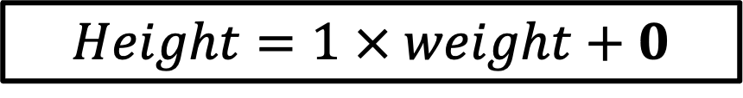
In this case, we will set intercept to 0 and the slope to 1 but any number will do.
Height
$$Height=1 × weight+0$$
Weight

Slide 11

And that gives us the equation for this line
Height
$$Height=slope × weight+0$$
Weight

Slide 12
Next, we will evaluate how well this line fits our data using Sum of Squared Error (SSE)
Height
Weight

Slide 13
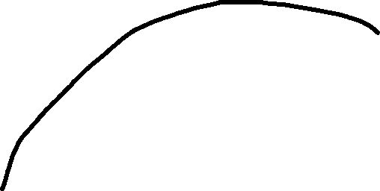
Let us calculate the residual or error for this datapoint
Height
Weight

Slide 14


$$SSE{=(observed height−predicted height)}^{2}$$
When we calculated SSE, the first residual was the difference between the observed height which was 1.4 and the predicted height which came from the equation of this line
Height
$$predicted height=slope × weight+intercept$$
Since this person weighed 0.5, the equation will be..
Weight
$$predicted height=slope × 0.5+intercept$$

Slide 15


$$SSE{=(observed height−predicted height)}^{2}$$
Plugging in the observed height and the predicted height for the first person we get..
Height
$$observed height=1.4$$
$$predicted height=slope × 0.5+intercept$$
$$SSE{=(1.4−(slope × 0.5+intercept))}^{2}$$
Weight

Slide 16
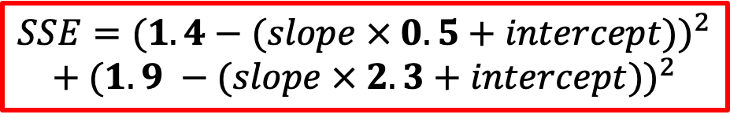


$$SSE{=(observed height−predicted height)}^{2}$$
Just like before, if we calculate the residual for the second person we get…
$$observed height=1.9$$
Height
Since this person weighed 2.3, the equation will be..
$$predicted height=slope × 2.3+intercept$$
Our SSE will now then be…
Weight
$$SSE{=(1.4−(slope × 0.5+intercept))}^{2}$$
$$+ {(1.9 −(slope × 2.3+intercept))}^{2}$$

Slide 17
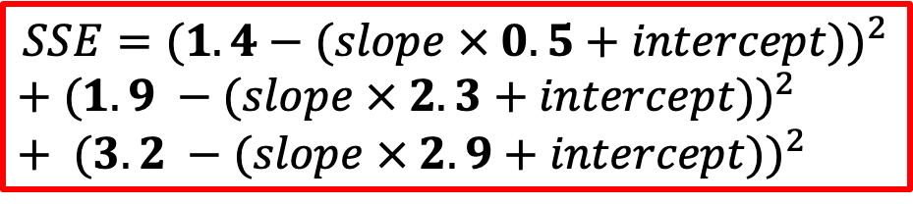


$$SSE{=(observed height−predicted height)}^{2}$$
For the third person if the observed height is…
$$observed height=3.2$$
Height
And since this person weighed 2.9, the equation will be..
$$predicted height=slope × 2.9+intercept$$
Our final SSE will now the be…
Weight
$$SSE{=(1.4−(slope × 0.5+intercept))}^{2}$$
$+ {(1.9 −(slope × 2.3+intercept))}^{2}$ $+ {(3.2 −(slope × 2.9+intercept))}^{2}$

Slide 18
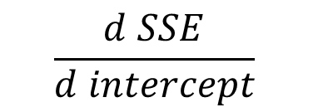
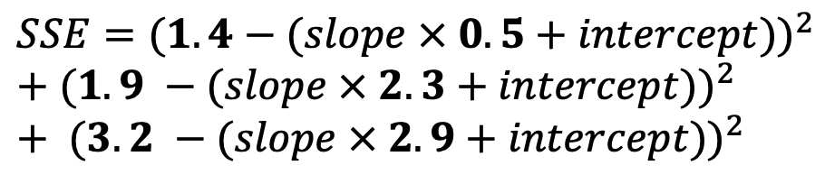
The next step is to take the derivate of the SSE with respect to the intercept
$$SSE{=(1.4−(slope × 0.5+intercept))}^{2}$$
$+ {(1.9 −(slope × 2.3+intercept))}^{2}$ $+ {(3.2 −(slope × 2.9+intercept))}^{2}$
$$\frac{d SSE}{d intercept}$$

Slide 19
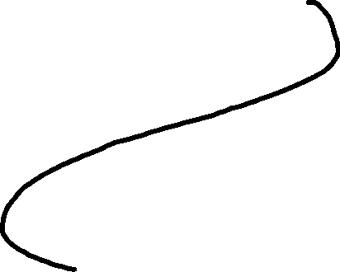
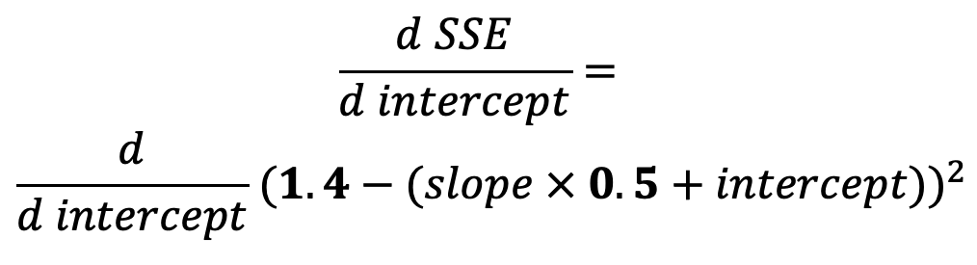
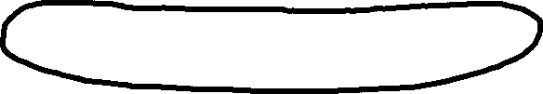
$$SSE{=(1.4−(slope × 0.5+intercept))}^{2}$$
$+ {(1.9 −(slope × 2.3+intercept))}^{2}$ $+ {(3.2 −(slope × 2.9+intercept))}^{2}$
The derivative of SSE with respect to the intercept is equal to the derivative of the first part
$$\frac{d SSE}{d intercept}=$$
$$\frac{d}{d intercept}{ (1.4−(slope × 0.5+intercept))}^{2}$$

Slide 20
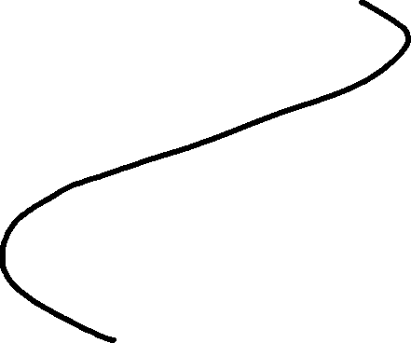
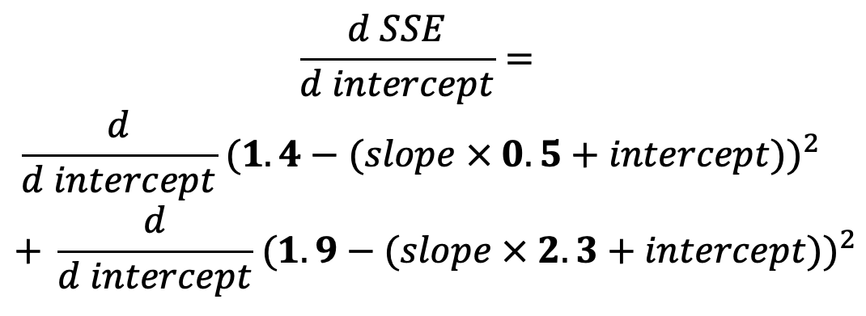
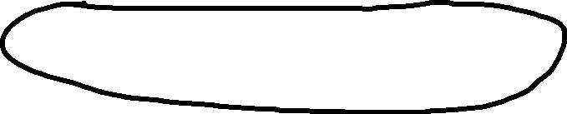
$$SSE{=(1.4−(slope × 0.5+intercept))}^{2}$$
$+ {(1.9 −(slope × 2.3+intercept))}^{2}$ $+ {(3.2 −(slope × 2.9+intercept))}^{2}$
Plus the derivative of the second part
$$\frac{d SSE}{d intercept}=$$
$$\frac{d}{d intercept}{ (1.4−(slope × 0.5+intercept))}^{2}$$
$$+ \frac{d}{d intercept}{ (1.9−(slope × 2.3+intercept))}^{2}$$

Slide 21
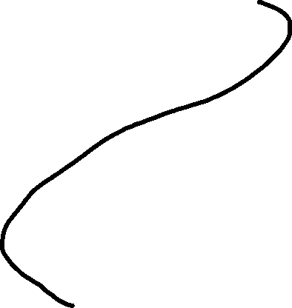
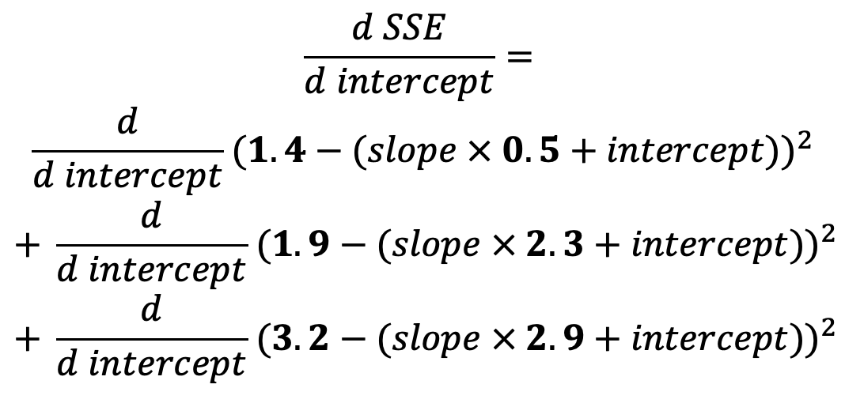
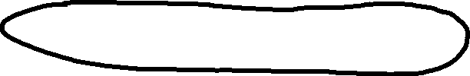
$$SSE{=(1.4−(slope × 0.5+intercept))}^{2}$$
$+ {(1.9 −(slope × 2.3+intercept))}^{2}$ $+ {(3.2 −(slope × 2.9+intercept))}^{2}$
Plus the derivative of the third part
$$\frac{d SSE}{d intercept}=$$
$$\frac{d}{d intercept}{ (1.4−(slope × 0.5+intercept))}^{2}$$
$$+ \frac{d}{d intercept}{ (1.9−(slope × 2.3+intercept))}^{2}$$
$$+ \frac{d}{d intercept}{ (3.2−(slope × 2.9+intercept))}^{2}$$

Slide 22



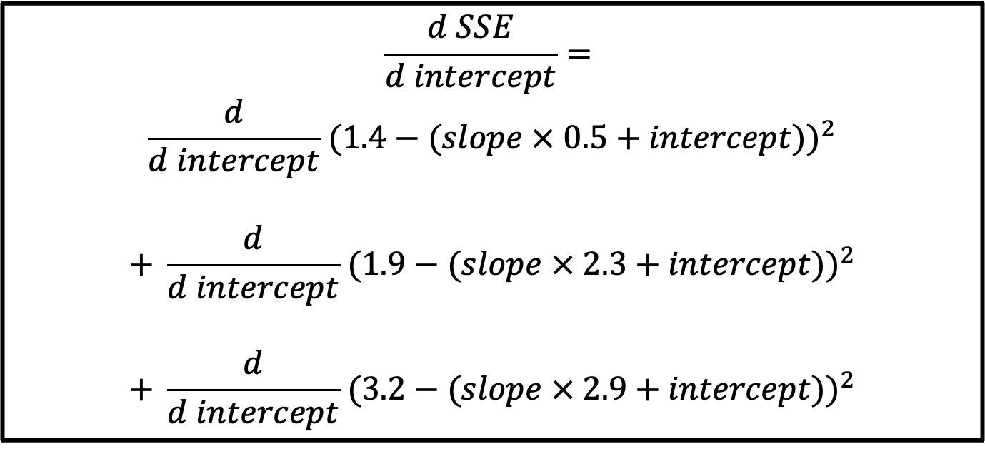
$$\frac{d SSE}{d intercept}=$$
$$\frac{d}{d intercept}{ (1.4−(slope × 0.5+intercept))}^{2}$$
$$+ \frac{d}{d intercept}{ (1.9−(slope × 2.3+intercept))}^{2}$$
$$+ \frac{d}{d intercept}{ (3.2−(slope × 2.9+intercept))}^{2}$$
We have to get the derivatives of these three expressions in order to get the derivative of SSE with respect to the intercept.

Slide 23
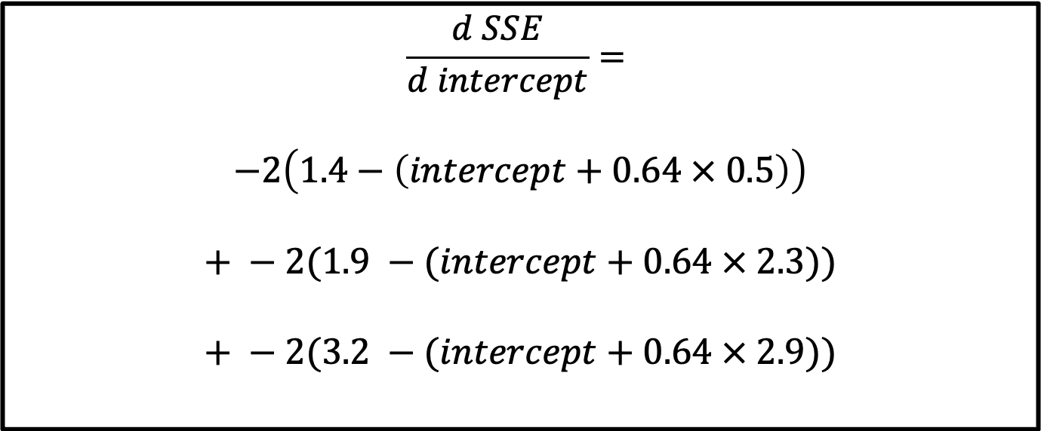
$$\frac{d SSE}{d intercept}=$$
$$−2\left(1.4−\left(intercept+0.64 × 0.5\right)\right)$$
$$+ −2(1.9 −(intercept+0.64 × 2.3))$$
$$+ −2(3.2 −(intercept+0.64 × 2.9))$$
These are the derivatives for all expressions

Slide 24
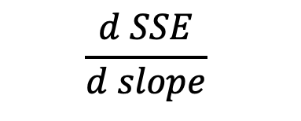
The next step is to take the derivate of the SSE with respect to the slope
$$SSE{=(1.4−(slope × 0.5+intercept))}^{2}$$
$+ {(1.9 −(slope × 2.3+intercept))}^{2}$ $+ {(3.2 −(slope × 2.9+intercept))}^{2}$
$$\frac{d SSE}{d slope}$$

Slide 25
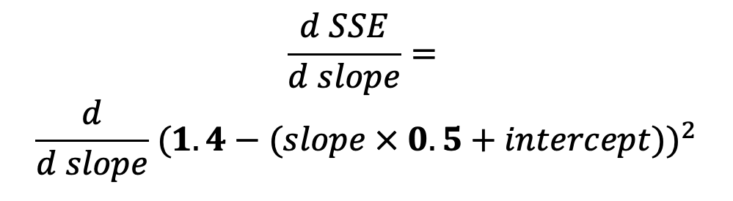
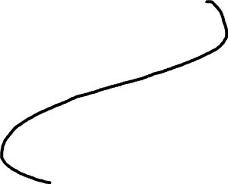

$$SSE{=(1.4−(slope × 0.5+intercept))}^{2}$$
$+ {(1.9 −(slope × 2.3+intercept))}^{2}$ $+ {(3.2 −(slope × 2.9+intercept))}^{2}$
The derivative of SSE with respect to the intercept is equal to the derivative of the first part
$$\frac{d SSE}{d slope}=$$
$$\frac{d}{d slope}{ (1.4−(slope × 0.5+intercept))}^{2}$$

Slide 26
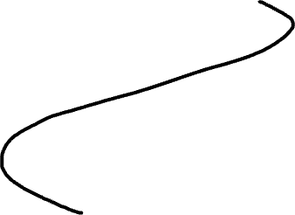
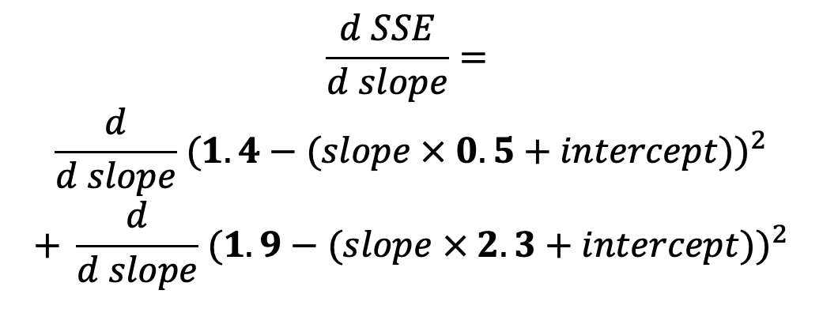
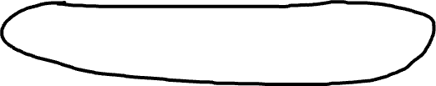
$$SSE{=(1.4−(slope × 0.5+intercept))}^{2}$$
$+ {(1.9 −(slope × 2.3+intercept))}^{2}$ $+ {(3.2 −(slope × 2.9+intercept))}^{2}$
Plus the derivative of the second part
$$\frac{d SSE}{d slope}=$$
$$\frac{d}{d slope}{ (1.4−(slope × 0.5+intercept))}^{2}$$
$$+ \frac{d}{d slope}{ (1.9−(slope × 2.3+intercept))}^{2}$$

Slide 27
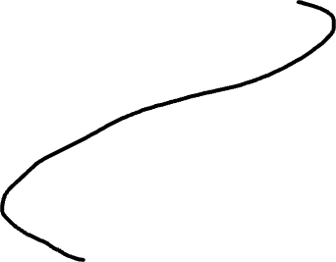
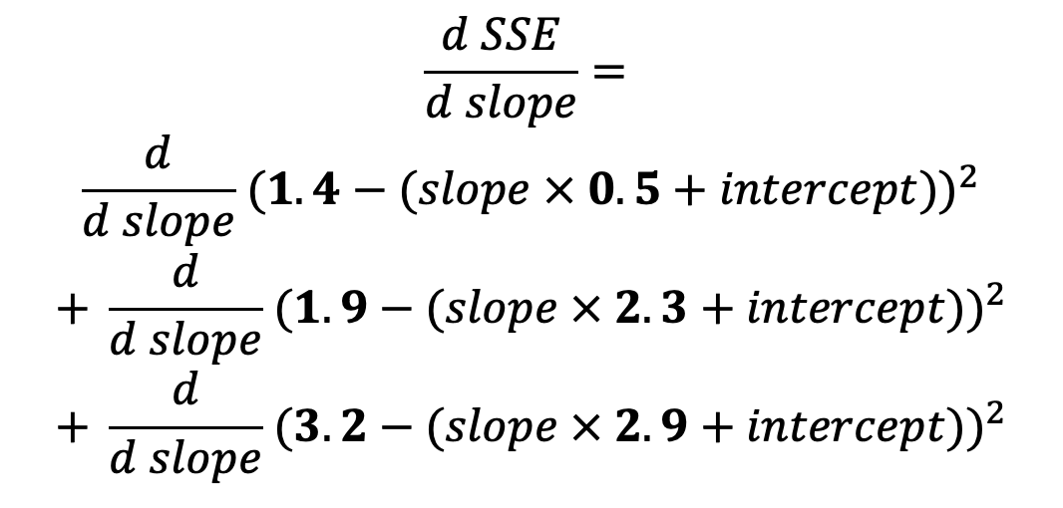

$$SSE{=(1.4−(slope × 0.5+intercept))}^{2}$$
$+ {(1.9 −(slope × 2.3+intercept))}^{2}$ $+ {(3.2 −(slope × 2.9+intercept))}^{2}$
Plus the derivative of the third part
$$\frac{d SSE}{d slope}=$$
$$\frac{d}{d slope}{ (1.4−(slope × 0.5+intercept))}^{2}$$
$$+ \frac{d}{d slope}{ (1.9−(slope × 2.3+intercept))}^{2}$$
$$+ \frac{d}{d slope}{ (3.2−(slope × 2.9+intercept))}^{2}$$

Slide 28
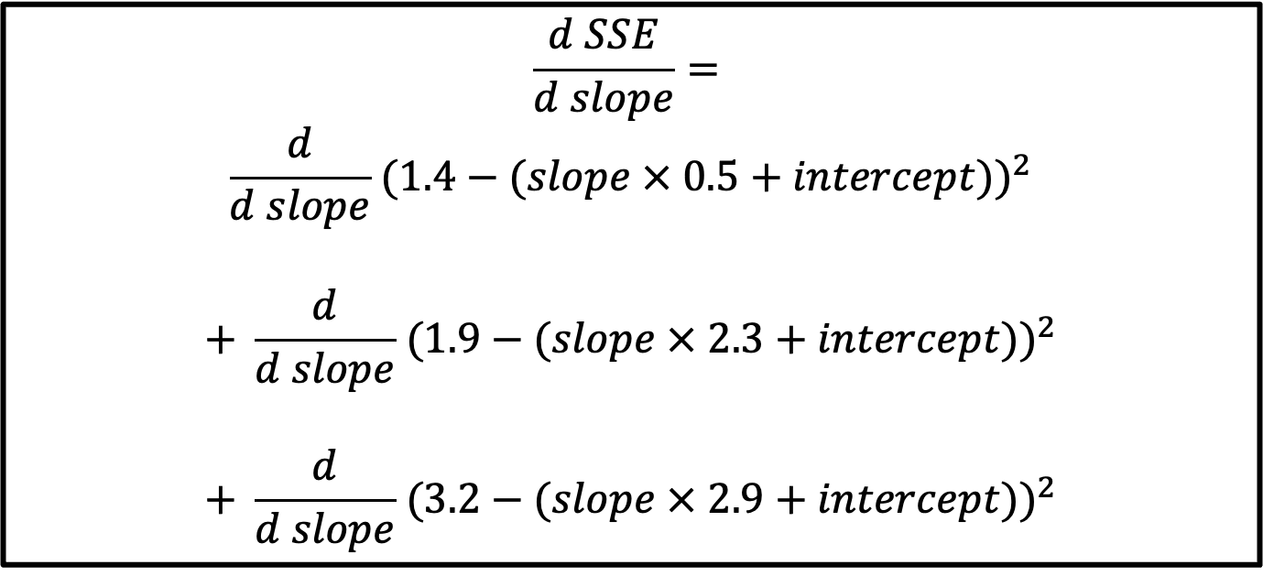
$$\frac{d SSE}{d slope}=$$
$$\frac{d}{d slope}{ (1.4−(slope × 0.5+intercept))}^{2}$$
$$+ \frac{d}{d slope}{ (1.9−(slope × 2.3+intercept))}^{2}$$
$$+ \frac{d}{d slope}{ (3.2−(slope × 2.9+intercept))}^{2}$$
We have to get the derivatives of these three expressions in order to get the derivative of SSE with respect to the intercept.

Slide 29
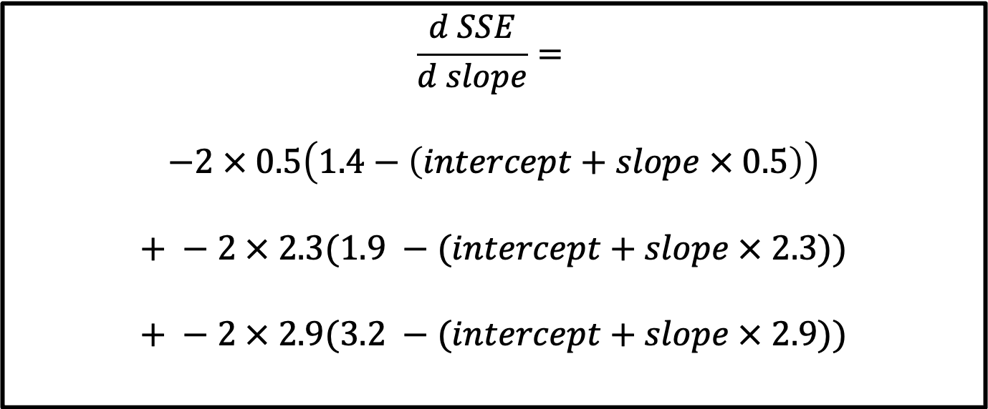
$$\frac{d SSE}{d slope}=$$
$$−2 × 0.5\left(1.4−\left(intercept+slope × 0.5\right)\right)$$
$$+ −2 × 2.3(1.9 −(intercept+slope × 2.3))$$
$$+ −2 × 2.9(3.2 −(intercept+slope × 2.9))$$
These are the derivatives for all expressions

Slide 30
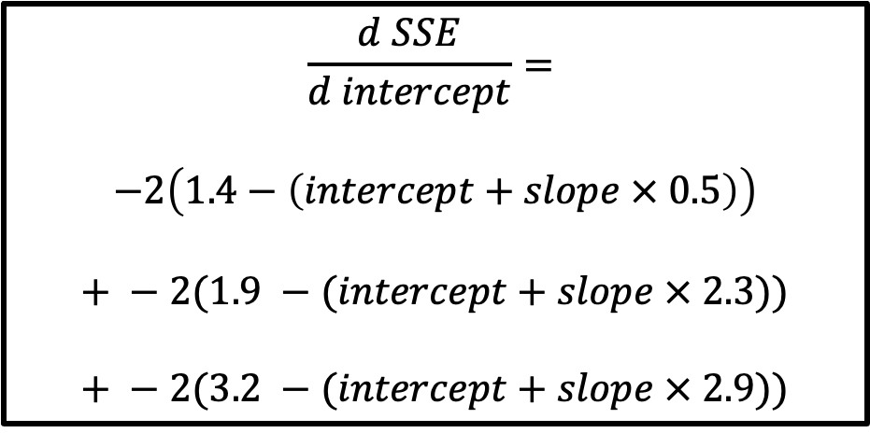
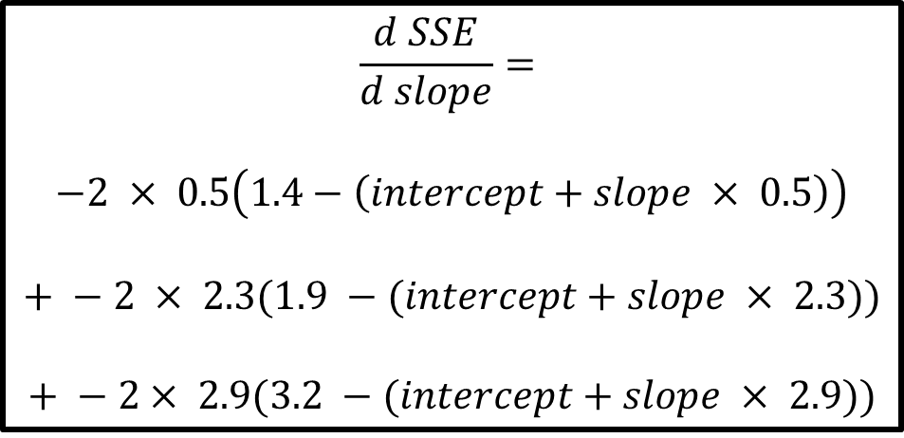
$$\frac{d SSE}{d intercept}=$$
$$−2\left(1.4−\left(intercept+slope × 0.5\right)\right)$$
$$+ −2(1.9 −(intercept+slope × 2.3))$$
$$+ −2(3.2 −(intercept+slope × 2.9))$$
$$\frac{d SSE}{d slope}=$$
$$−2 × 0.5\left(1.4−\left(intercept+slope × 0.5\right)\right)$$
$$+ −2 × 2.3(1.9 −(intercept+slope × 2.3))$$
$$+ −2× 2.9(3.2 −(intercept+slope × 2.9))$$
Now we have the derivatives, we will plug in the initial value 0 for the intercept and 1 for the slope.

Slide 31
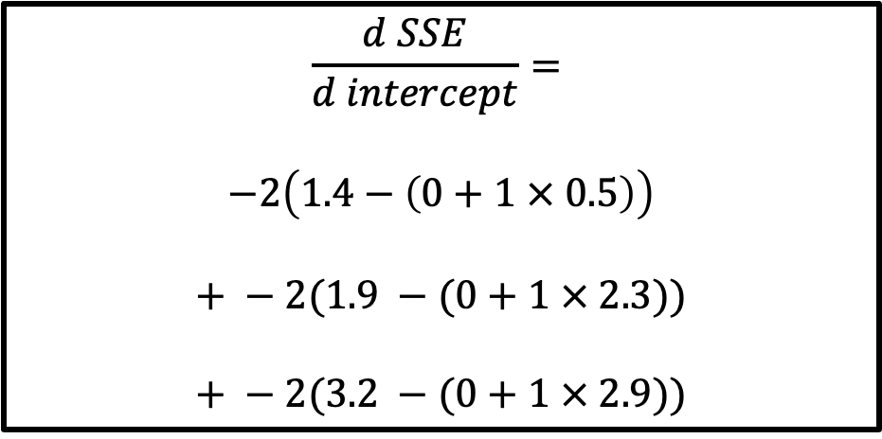
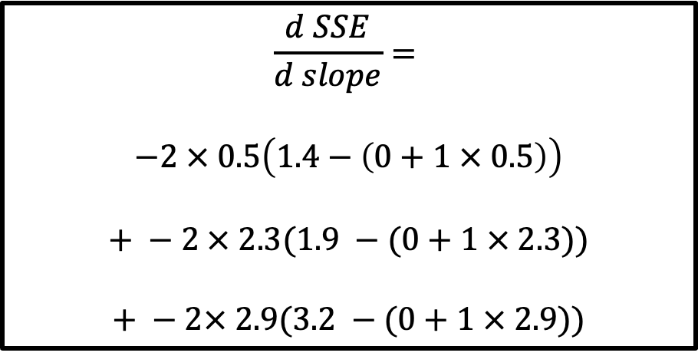
$$\frac{d SSE}{d intercept}=$$
$$−2\left(1.4−\left(0+1 × 0.5\right)\right)$$
$$+ −2(1.9 −(0+1 × 2.3))$$
$$+ −2(3.2 −(0+1 × 2.9))$$
$$\frac{d SSE}{d slope}=$$
$$−2 × 0.5\left(1.4−\left(0+1 × 0.5\right)\right)$$
$$+ −2 × 2.3(1.9 −(0+1 × 2.3))$$
$$+ −2× 2.9(3.2 −(0+1 × 2.9))$$
And calculate the slopes each one.

Slide 32
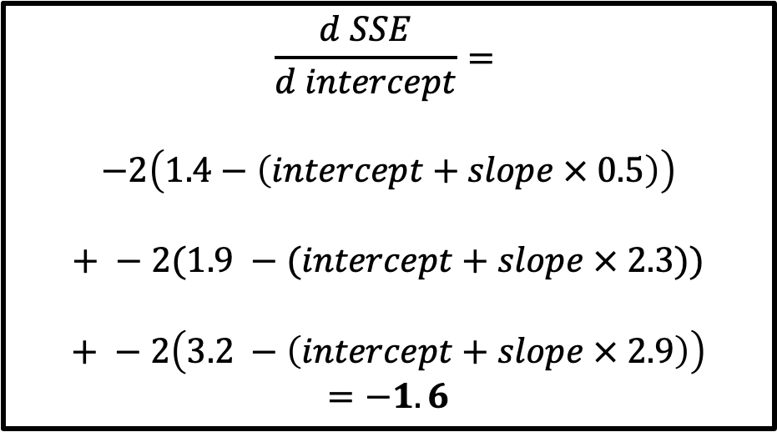
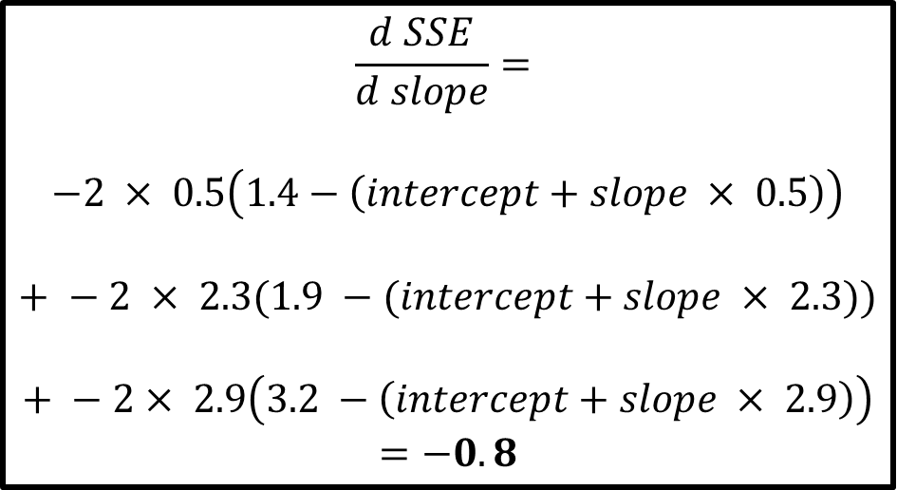
$$\frac{d SSE}{d intercept}=$$
$$−2\left(1.4−\left(intercept+slope × 0.5\right)\right)$$
$$+ −2(1.9 −(intercept+slope × 2.3))$$
$$+ −2\left(3.2 −\left(intercept+slope × 2.9\right)\right)$$
$$=−1.6$$
$$\frac{d SSE}{d slope}=$$
$$−2 × 0.5\left(1.4−\left(intercept+slope × 0.5\right)\right)$$
$$+ −2 × 2.3(1.9 −(intercept+slope × 2.3))$$
$$+ −2× 2.9\left(3.2 −\left(intercept+slope × 2.9\right)\right)$$
$$=−0.8$$
$$Step Size=Slope × Learning Rate$$
We then plug in the slopes to the Step Size formula

Slide 33


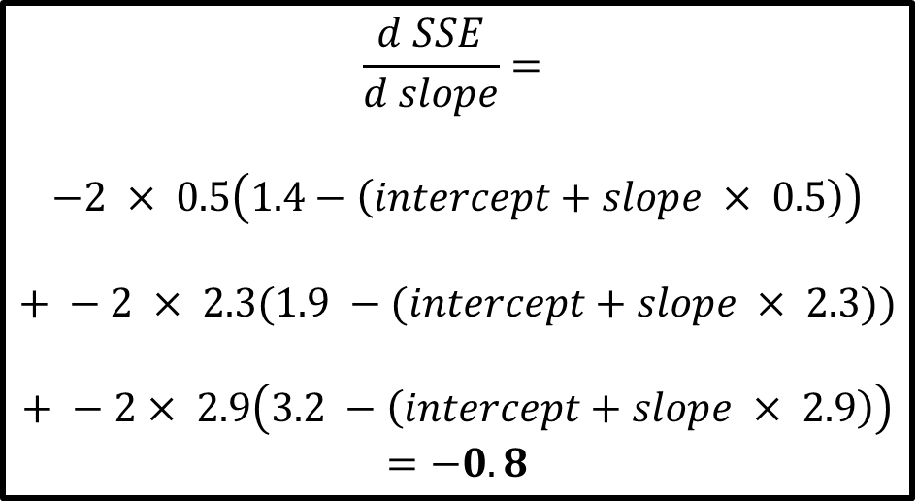
$$\frac{d SSE}{d intercept}=$$
$$−2\left(1.4−\left(intercept+slope × 0.5\right)\right)$$
$$+ −2(1.9 −(intercept+slope × 2.3))$$
$$+ −2\left(3.2 −\left(intercept+slope × 2.9\right)\right)$$
$$=−1.6$$
$$\frac{d SSE}{d slope}=$$
$$−2 × 0.5\left(1.4−\left(intercept+slope × 0.5\right)\right)$$
$$+ −2 × 2.3(1.9 −(intercept+slope × 2.3))$$
$$+ −2× 2.9\left(3.2 −\left(intercept+slope × 2.9\right)\right)$$
$$=−0.8$$
$$Step Size=Slope × Learning Rate$$
$$Step Size=−1.6 × 0.01=−0.016$$
$$Step Size=−0.8 × 0.01=−0.008$$

Slide 34


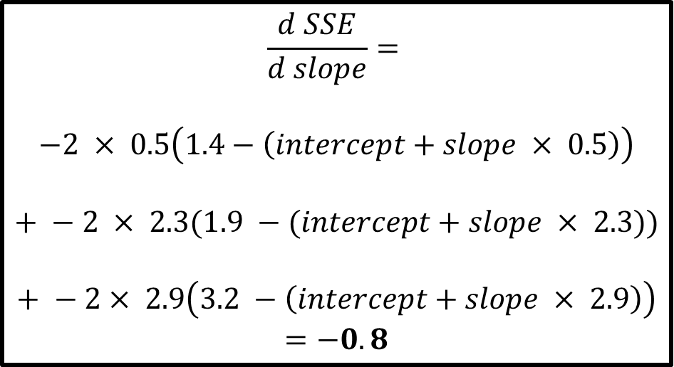
$$\frac{d SSE}{d intercept}=$$
$$−2\left(1.4−\left(intercept+slope × 0.5\right)\right)$$
$$+ −2(1.9 −(intercept+slope × 2.3))$$
$$+ −2\left(3.2 −\left(intercept+slope × 2.9\right)\right)$$
$$=−1.6$$
$$\frac{d SSE}{d slope}=$$
$$−2 × 0.5\left(1.4−\left(intercept+slope × 0.5\right)\right)$$
$$+ −2 × 2.3(1.9 −(intercept+slope × 2.3))$$
$$+ −2× 2.9\left(3.2 −\left(intercept+slope × 2.9\right)\right)$$
$$=−0.8$$
$$Step Size=−0.016$$
$$Step Size=−0.008$$
$$New Intercept=Old Intercept × Step Size$$
$$New Intercept=Old Slope × Step Size$$
Finally we calculate the New Intercept and New Slope

Slide 35
$$\frac{d SSE}{d intercept}=$$
$$−2\left(1.4−\left(intercept+slope × 0.5\right)\right)$$
$$+ −2(1.9 −(intercept+slope × 2.3))$$
$$+ −2\left(3.2 −\left(intercept+slope × 2.9\right)\right)$$
$$=−1.6$$
$$\frac{d SSE}{d slope}=$$
$$−2 × 0.5\left(1.4−\left(intercept+slope × 0.5\right)\right)$$
$$+ −2 × 2.3(1.9 −(intercept+slope × 2.3))$$
$$+ −2× 2.9\left(3.2 −\left(intercept+slope × 2.9\right)\right)$$
$$=−0.8$$
$$Step Size=−0.016$$
$$Step Size=−0.008$$
$$New Intercept=Old Intercept − Step Size$$
$$New Intercept=Old Slope − Step Size$$
$$New Intercept=0 −(−0.016)=0.016$$
$$New Intercept=1−(−0.008)=1.008$$

Slide 36
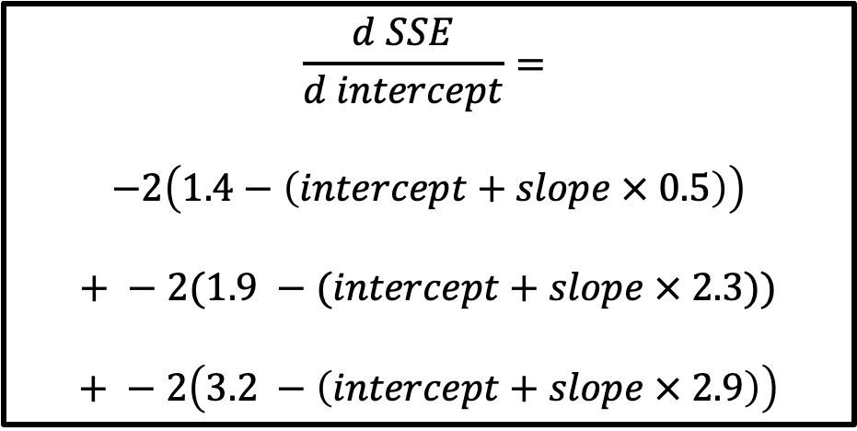
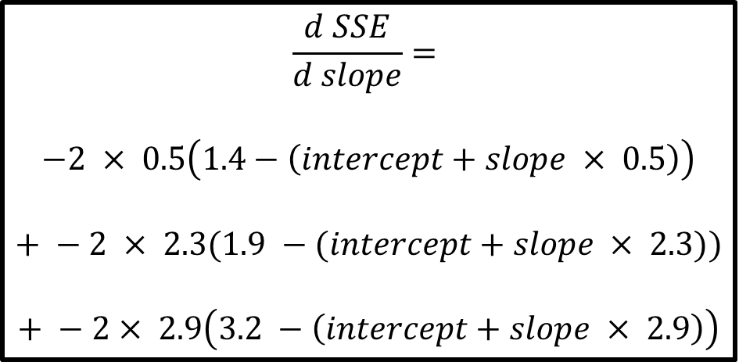
$$\frac{d SSE}{d intercept}=$$
$$−2\left(1.4−\left(intercept+slope × 0.5\right)\right)$$
$$+ −2(1.9 −(intercept+slope × 2.3))$$
$$+ −2\left(3.2 −\left(intercept+slope × 2.9\right)\right)$$
$$\frac{d SSE}{d slope}=$$
$$−2 × 0.5\left(1.4−\left(intercept+slope × 0.5\right)\right)$$
$$+ −2 × 2.3(1.9 −(intercept+slope × 2.3))$$
$$+ −2× 2.9\left(3.2 −\left(intercept+slope × 2.9\right)\right)$$
This process is repeated until the Step Size will be very close to 0 or if we took the maximum number of steps specified.

Slide 37
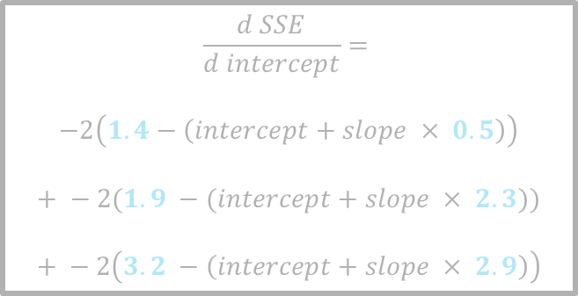
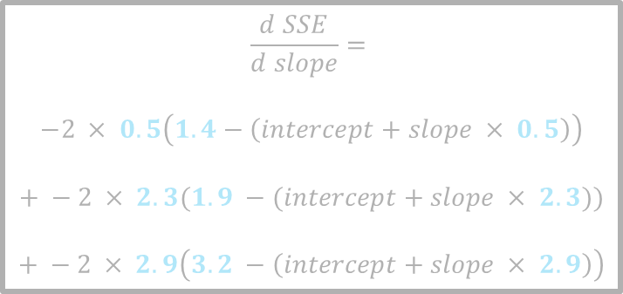
$$\frac{d SSE}{d intercept}=$$
$$−2\left(1.4−\left(intercept+slope × 0.5\right)\right)$$
$$+ −2(1.9 −(intercept+slope × 2.3))$$
$$+ −2\left(3.2 −\left(intercept+slope × 2.9\right)\right)$$
In this example, we were just fitting the line with two parameters, the intercept and the slope
$$\frac{d SSE}{d slope}=$$
$$−2 × 0.5\left(1.4−\left(intercept+slope × 0.5\right)\right)$$
$$+ −2 × 2.3(1.9 −(intercept+slope × 2.3))$$
$$+ −2 × 2.9\left(3.2 −\left(intercept+slope × 2.9\right)\right)$$
Height
Weight

Slide 38
$$\frac{d SSE}{d intercept}=$$
$$−2\left(1.4−\left(intercept+slope × 0.5\right)\right)$$
$$+ −2(1.9 −(intercept+slope × 2.3))$$
$$+ −2\left(3.2 −\left(intercept+slope × 2.9\right)\right)$$
And we only had three data points
$$\frac{d SSE}{d slope}=$$
$$−2 × 0.5\left(1.4−\left(intercept+slope × 0.5\right)\right)$$
$$+ −2 × 2.3(1.9 −(intercept+slope × 2.3))$$
$$+ −2 × 2.9\left(3.2 −\left(intercept+slope × 2.9\right)\right)$$
Height
Weight

Slide 39
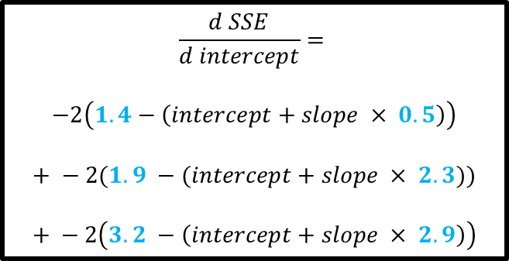
$$\frac{d SSE}{d intercept}=$$
$$−2\left(1.4−\left(intercept+slope × 0.5\right)\right)$$
$$+ −2(1.9 −(intercept+slope × 2.3))$$
$$+ −2\left(3.2 −\left(intercept+slope × 2.9\right)\right)$$
So we only had three terms to compute each step for the intercept
$$\frac{d SSE}{d slope}=$$
$$−2 × 0.5\left(1.4−\left(intercept+slope × 0.5\right)\right)$$
$$+ −2 × 2.3(1.9 −(intercept+slope × 2.3))$$
$$+ −2 × 2.9\left(3.2 −\left(intercept+slope × 2.9\right)\right)$$
Height
Weight

Slide 40
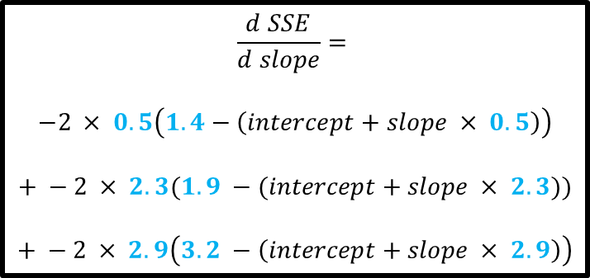
$$\frac{d SSE}{d intercept}=$$
$$−2\left(1.4−\left(intercept+slope × 0.5\right)\right)$$
$$+ −2(1.9 −(intercept+slope × 2.3))$$
$$+ −2\left(3.2 −\left(intercept+slope × 2.9\right)\right)$$
and we only had three terms to compute each step for the slope
$$\frac{d SSE}{d slope}=$$
$$−2 × 0.5\left(1.4−\left(intercept+slope × 0.5\right)\right)$$
$$+ −2 × 2.3(1.9 −(intercept+slope × 2.3))$$
$$+ −2 × 2.9\left(3.2 −\left(intercept+slope × 2.9\right)\right)$$
Height
Weight

Slide 41
There are a few downsides of the gradient descent algorithm.
Say we have 10,000 training examples and 10 features.
We need to compute the derivative of this function with respect to each of the features, so in effect we will be doing 10000 * 10 = 100,000 computations per iteration.
It is common to take 1000 epochs, in effect we have 100,000 * 1000 = 100000000 computations to complete the algorithm.
That is pretty much an overhead and this is why gradient descent is slow on huge data.

Slide 42
Computational Efficiency
There are a few downsides of the gradient descent algorithm.
Say we have 10,000 training examples and 10 features.
We need to compute the derivative of this function with respect to each of the features, so in effect we will be doing 10000 * 10 = 100,000 computations per iteration.
It is common to take 1000 epochs, in effect we have 100,000 * 1000 = 100000000 computations to complete the algorithm.
That is pretty much an overhead and this is why gradient descent is slow on huge data.

